Slide 1
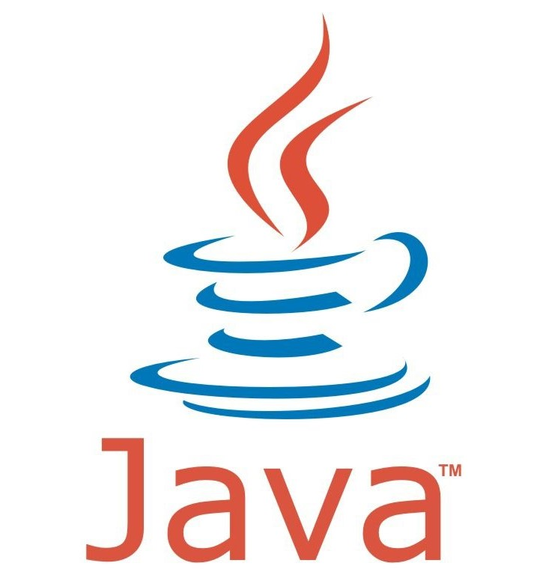
Understanding JAVA-OOPS With Real-Life Examples
Oops Concept in Java :
The OOP's concepts in Java facilitate organized, modular, and maintainable code, making it a popular choice for software development.
Object-oriented programming is a powerful prototype that helps developers build complex, modular, and scalable applications using the four pillars of OOP - Encapsulation, Inheritance, Polymorphism, and Abstraction. Let's dive deeper into each pillar.
PRATYUSH MUKUL GAIKWAD
Employee ID-46330616

Slide 2

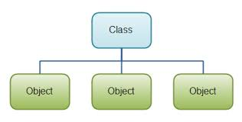
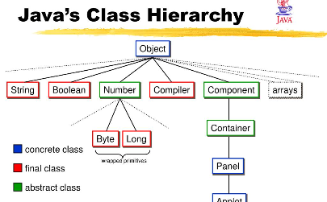
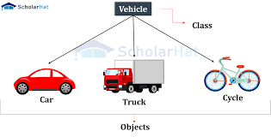
Classes and Objects
What are they?
How are they related?
What are their key features?
A class is a blueprint or template that defines the variables and methods of an object, while an object is an instance of a class.
Objects are created from classes, and the structure and behavior of objects are defined by their respective classes.
Classes can have fields, constructors, methods, and inner classes.

Slide 3


Encapsulation
1
What is it?
2
Why is it important?
Encapsulation is the process of hiding implementation details while exposing a public interface that can be used by other objects.
Encapsulation helps to prevent unauthorized access to sensitive data and ensures that objects can only be modified in controlled ways.
3
How is it implemented?
In Java, encapsulation is achieved through the use of access modifiers such as public, private, and protected.

Slide 4
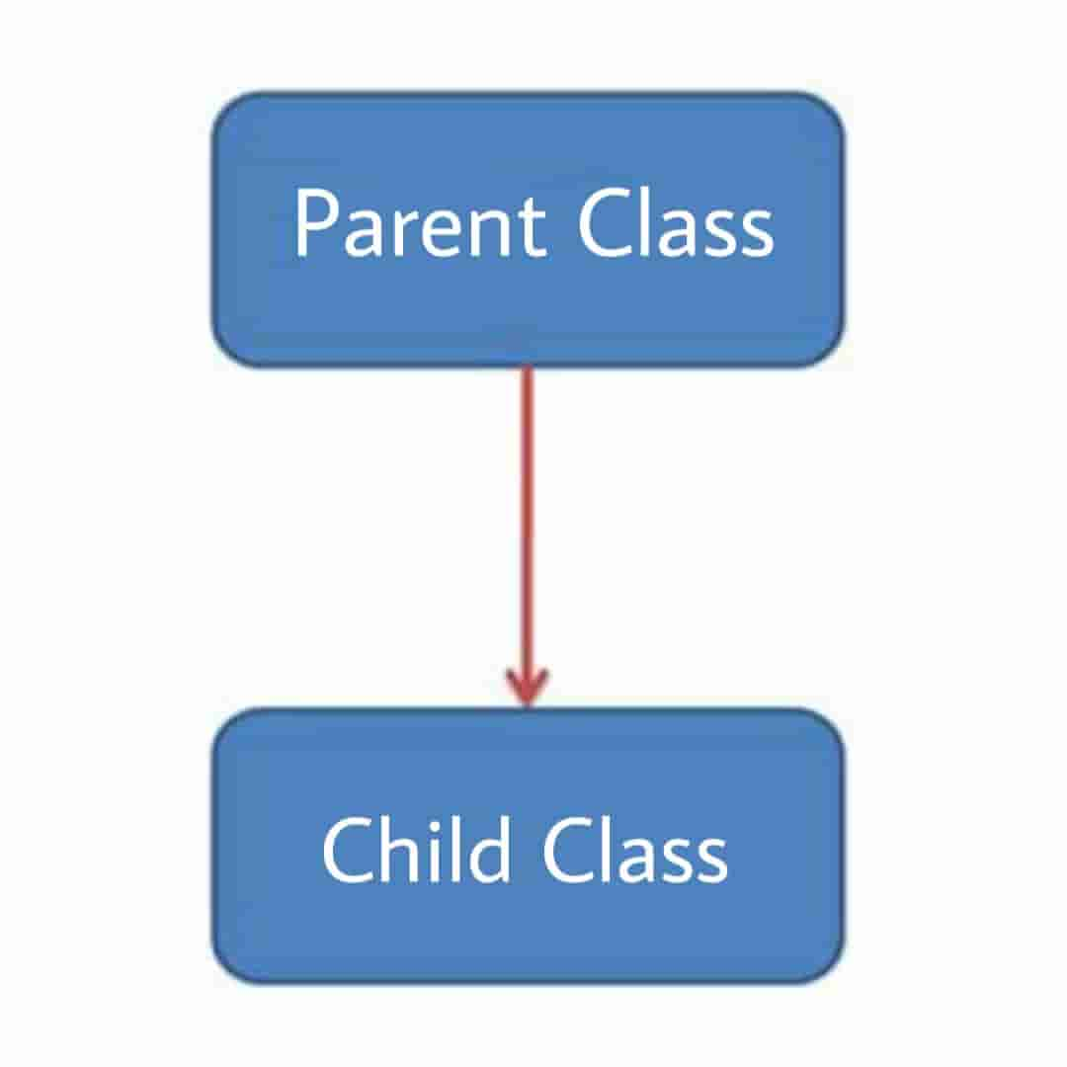
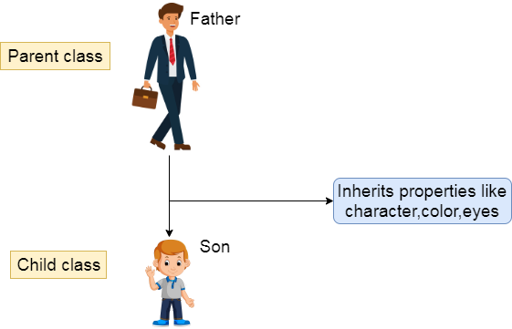
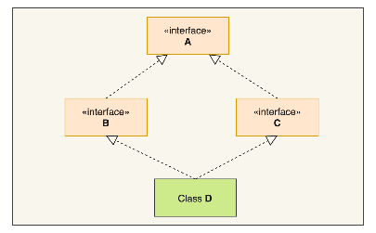
Inheritance
What is it?
Why is it important?
What are its types?
Inheritance is the process whereby a new class is created by inheriting properties and methods from an existing class.
Inheritance allows for code reuse, reduces redundant code, and makes it easier to maintain and update classes.
There are several types of inheritance in Java, including single, multiple, hierarchical, and hybrid inheritance.

Slide 5
Polymorphism
What is it?
Why is it important?
How is it implemented?
In Java, polymorphism is achieved through several mechanisms, including method overloading, method overriding, and interfaces.
Polymorphism is the ability of an object to take on many forms.
Polymorphism allows for the creation of flexible and dynamic code that can adapt to different input and output scenarios.

Slide 6
Abstraction
1
What is it?
Abstraction is the process of hiding implementation details while showing only the relevant information to the user.
Why is it important?
2
Abstraction allows for the creation of simpler and more modular code that is easier to understand, modify, and maintain.
3
How is it implemented?
In Java, abstraction is achieved through several features, including abstract classes, interfaces, and packages.

Slide 7
Benefits of Oops Concepts in Java
Modularity
Flexibility
Scalability
OOPS concepts allow for the creation of modular, reusable, and maintainable code.
OOPS concepts enable the creation of flexible and adaptable programs that can evolve over time.
OOPS concepts facilitate the development of scalable applications that can handle growing amounts of data and users.

Slide 8
Conclusion
By understanding the four pillars of OOP -Encapsulation, Inheritance, Polymorphism, and Abstraction - you can create more flexible, scalable, and maintainable code that can adapt to changing requirements, reduce technical debt, and improve software quality.

Slide 9

Thank You!

